Slide 1
Hardware

Slide 2
CAN: Hardware Specification
ISO 11898-1:2006/11898-1:2015 Road vehicles — Controller area
network (CAN) Part 1: Data link layer and physical signaling.
CAN controller tested with 1-Mbps CAN PHY
The Jetson TX2 supports connectivity to two CAN networks (but requires transceiver devices).
Features:
CAN protocol version 2.0A, version 2.0B and ISO 11898-1:2006/11898-1:2015
Parity check for Message RAM (optional)
Supports TT CAN

Slide 3
CAN: Software Specifications (Driver)
The Jetson TX2 BSP has no CAN driver pre-installed.
Linux provides CAN driver (Linux-CAN) that supports TX2 and is free to use.
An open source python library (python-can) provides APIs to use CAN driver within python code.
There is plenty of forums on NVIDIA website that describe how to use CAN on Jetson boards.

Slide 4
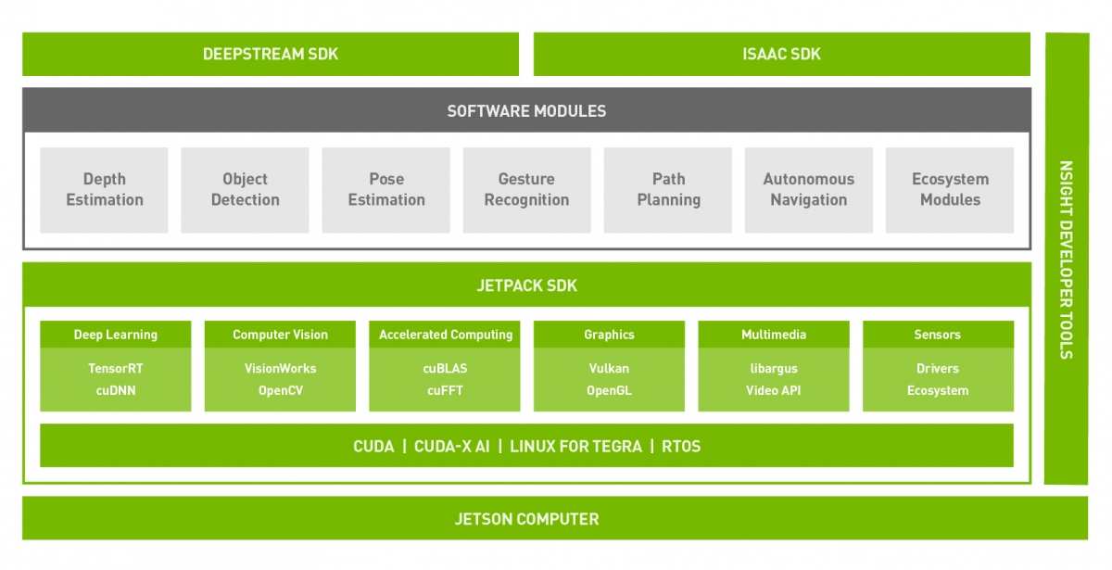
Software Stack

Slide 5
TensorFlow & GPU Programming On TX2
CUDA is a tool for GPU programming.
CUDA is originally C/C++, but an open source python implementation is available (pyCUDA).
TensorRT is a library built on top of CUDA for high-performance deep learning inference.
TensorRT has a python API that runs on TX2.
TensorFlow could be installed and run independently on TX2.
TensorFlow has TensorRT integration (TF-TRT).
pyTorch could also be installed on tx2.
to optimize pytorch network using TensorRT torch2rt could be used.

Slide 6
Developer Tools (IDEs)
Python could be installed on TX2.
For python development, there is no pre-installed IDE.
JetPack provides profiling and debugging tools that works with python code.
Third-party python IDEs could be installed.

Slide 7
Software

Slide 8
Datasets
Sleepy datasets
Distracted datasets

Slide 9
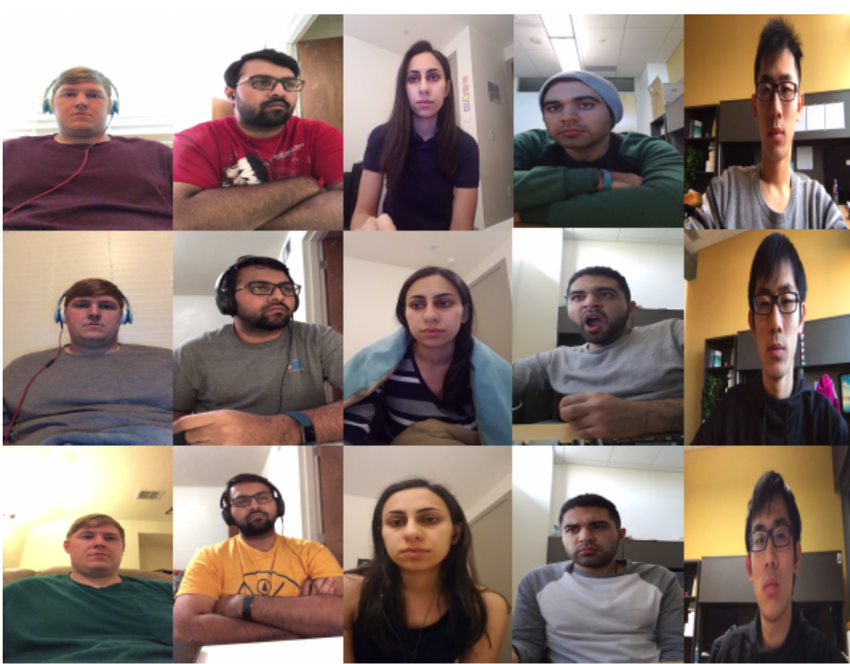
Sleepy datasets
UTA Real-Life Drowsiness Dataset
180 RGB videos. Each video is around 10 minutes long.

Slide 10
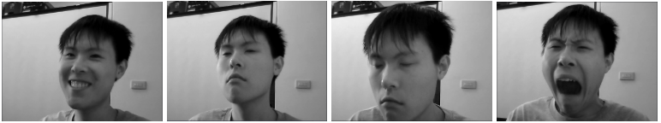
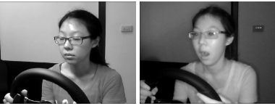
Sleepy datasets
Driver Drowsiness Dataset
the entire dataset is about 9 and a half hours.
License agreement is needed.

Slide 11
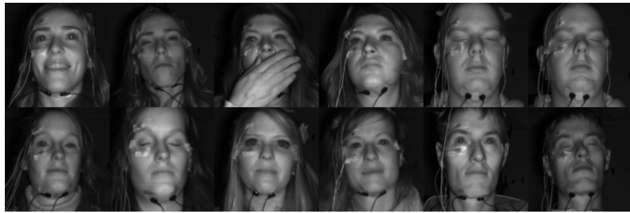
Sleepy datasets
ULg Multimodality Drowsiness Dataset
License agreement is needed.

Slide 12
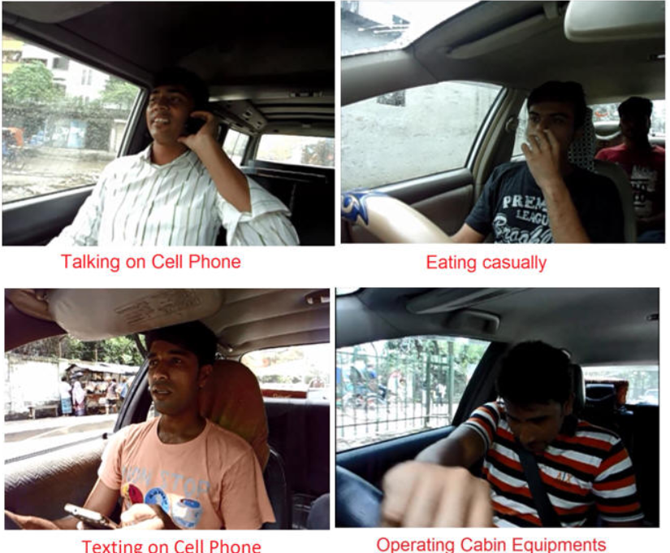
Distraction datasets
EEE BUET Distracted Driving Dataset
854x480 pixels with a frame rate of 30 fps.
Password to unzip the dataset is needed

Slide 13
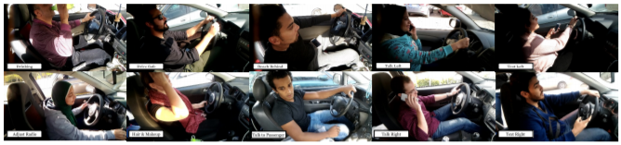
Distraction datasets
AUC Distracted Driver’s Dataset
License agreement needed.

Slide 14
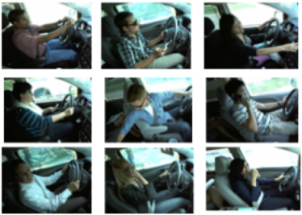
Distraction datasets
StateFarm’s Dataset
Kaggle competition dataset.

Slide 15
Solutions
Make new dataset for distraction task
Using transfer learning to have 1 pipeline for all tasks
Use second camera
Dividing tasks

Slide 16
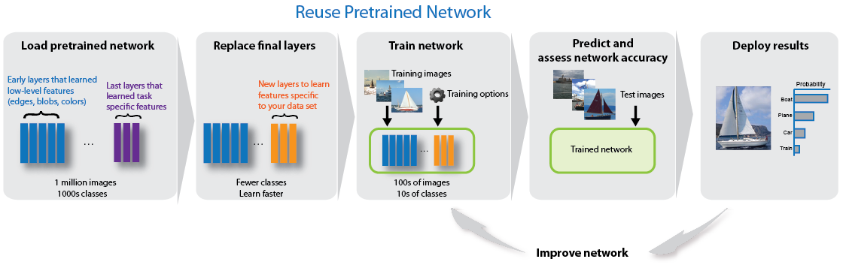
1. Using transfer learning to have 1 pipeline for all tasks
Use pretrained CNN for some task as a core for our model and retrain this CNN on our data sets

Slide 17
1. Using transfer learning to have 1 pipeline for all tasks
Freezing most of the layers while fine tuning the latest layers for each task separately
frontal images dataset for distraction detection is required

Slide 18
2. Dividing tasks
Using two pipelines:
First one is used for sleeping detection and emotion detection
The second is used for distraction detection
Different inputs are possible in this method : we can use different image size for each pipeline or use frontal camera for the first task and side camera for the second task

Slide 19
2. Dividing tasks
Using three pipelines:
Giving the same importance for all tasks
Different inputs are possible
Trade off between accuracies and computations over head : high accuracy may require deep CNN with high number of parameters

